Slide 1


Slide 2

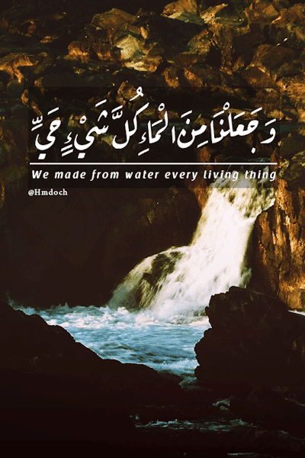
TITLE PAGE
We made from water every living thing

Slide 3
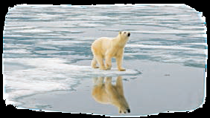

Global Warming
Why do we face global warming?
Can you speak about the damaging effects of global warming?

Slide 4
Litter
What is the best solution to avoid this kind of scenes?
Is education helpful to prevent litter?

Slide 5
Deforestation
What are the main causes of deforestation?
What are the effects of deforestration?

Slide 6
Drought
Can you say three factors which cause drought?
What are problems caused by drought?

Slide 7


GET READY
a
b
putting out the fire
a
hurting the animal
b
d
c
cutting down the trees
helping the injured animal
c
Put out the fire # Set on the fire
hurt = damage, harm
d
hurting the animal
putting out the fire
Good
Bad
helping the injured animal
cutting down the trees

Slide 8
a whale
an elephant
a panda
a leopard
vegetarian
a goat
a wolf
a panda
an elephant
carnivorous
a whale
a cat
a leopard
a duck
a wolf
a goat
a duck
a cat

Slide 9
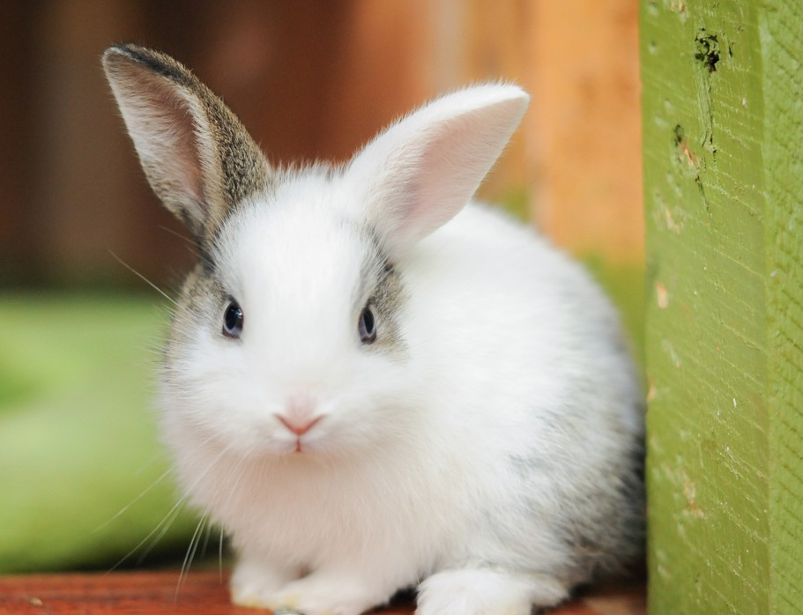
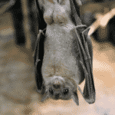
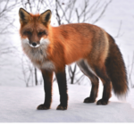

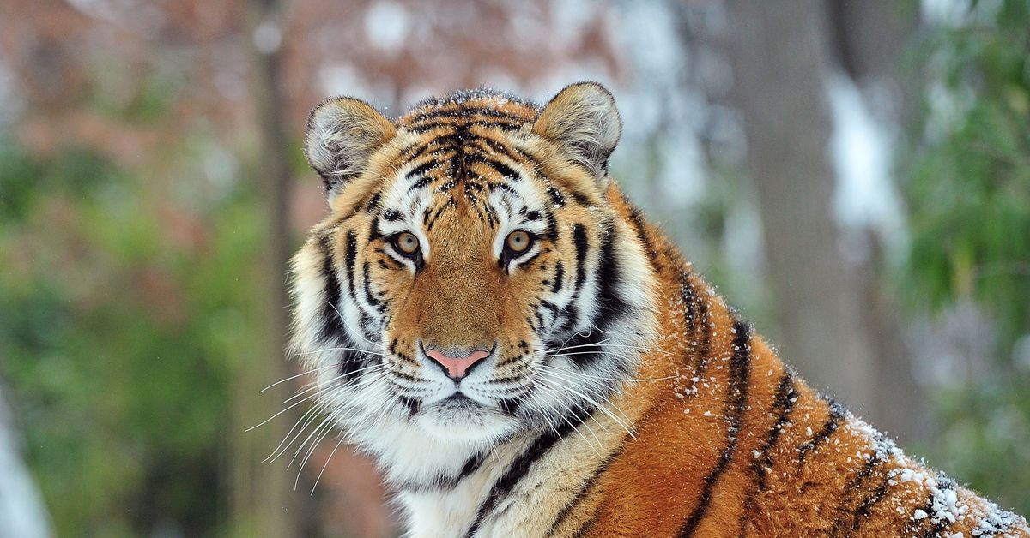
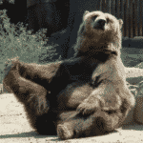
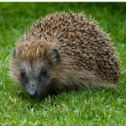
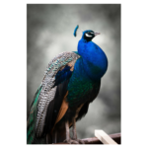
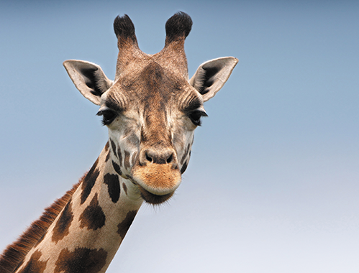
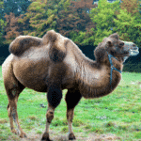
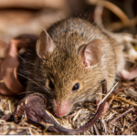
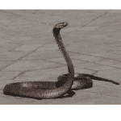
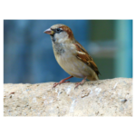
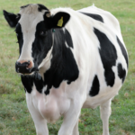
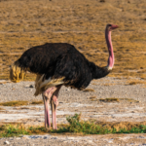
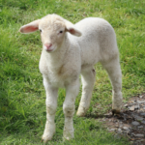
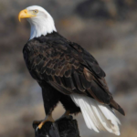
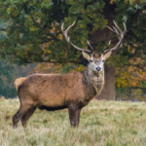
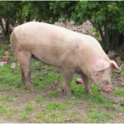
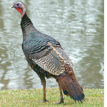
rabbit
bat
fox
owl
tiger
tolerate
hedgehog
peacock
giraffe
camel
mouse
snake
parrot
ostrich
cow
sheep
eagle
deer
pig
turkey

