Slide 1
Action Verbs
State Verbs
Lesson 3

Slide 2
verb
فعل کلمه ای است که بیانگر یک عمل و کار و یا روی دادن حالتی است

Slide 3
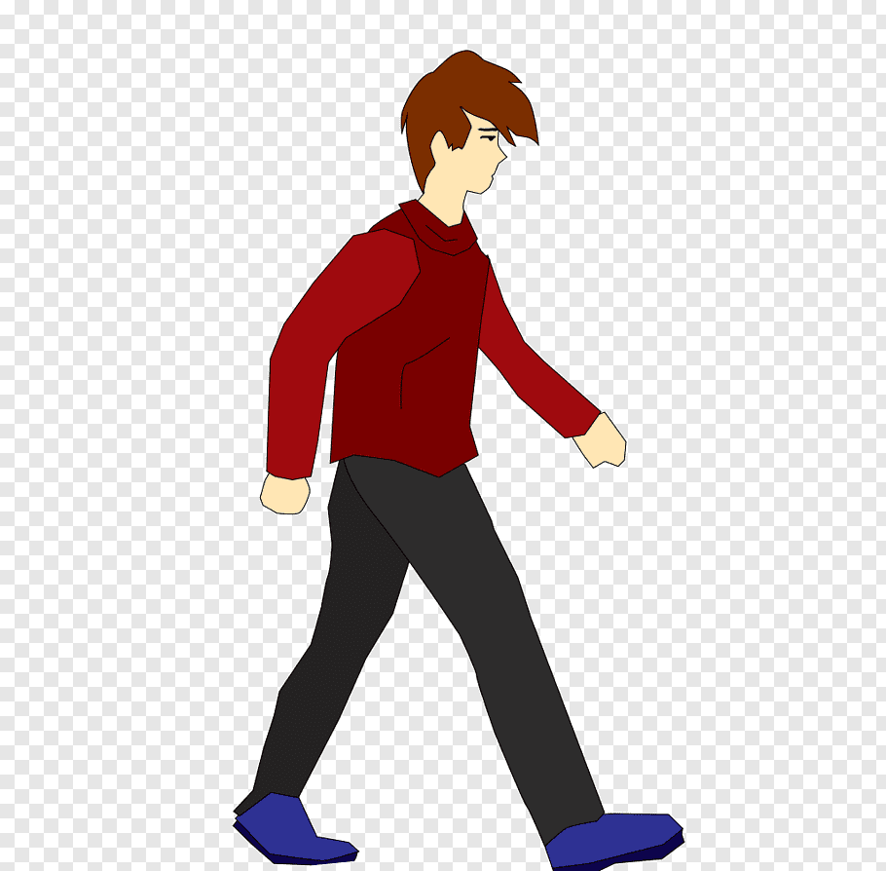
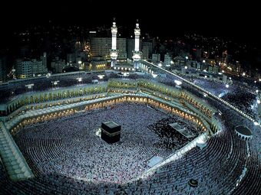
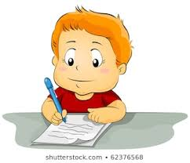

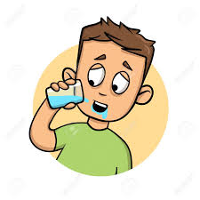

verb
He walks every night.
We believe in Allah.
He was writing a letter.
We love our country.
He drinks water every morning.
He feels happy.

Slide 4
verbs
Which of the following words is a verb?
Newspaper Eat
Protect Story
Learn Experiment
Book Invent
Planets Find

Slide 5
verbs
Action
State

Slide 6
Action Verbs
فعل های پویا ((Action Verbsافعالی هستند که بیانگر کار و یا عمل هستند.
یعنی فرد فاعل، کار فیزیکی انجام می دهد.
He was driving very fast in the high way.
They work hard on the problem.
Nurses help patients.
She translated the Holy Quran in 1380.

Slide 7

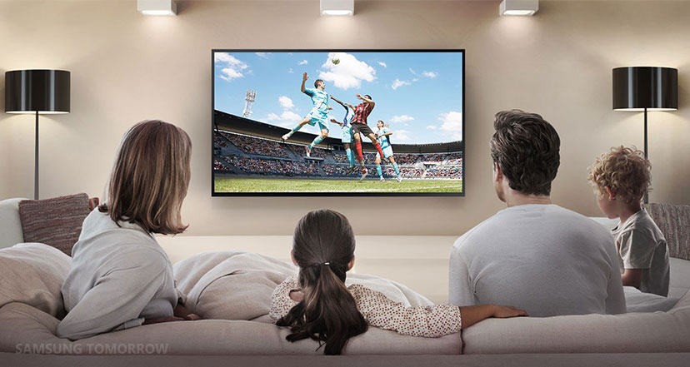
Action Verbs
watch
write

Slide 8
Action Verbs
They watch TV every day.
They are watching TV now.

Slide 9
Action Verbs
She writes a story every year.
She is writing a story at the moment.

Slide 10
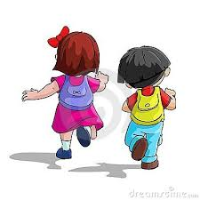
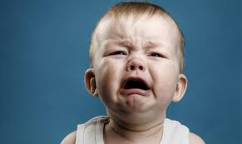


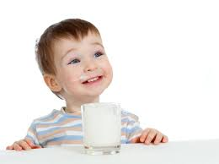

I tell you some verbs. Show them by some actions.
write
go
drink
cry
think
continuous
Sth happens
simple

Slide 11
Mary a letter.
is writing
We to school every day.
go
Andy always milk.
drinks

Slide 12
State Verbs
فعل های ایستا (state verbs (افعالی هستند که بیانگر حالت، احساس، فکر و عقیده هستند.
فاعل جمله کاری انجام نمی دهد.فاعل حرکتی نمی کند.
این فعل ها درونی هستند. مربوط به قلب و مغز ما هستند.
We believe in Allah.
He loves ice-cream.
He feels happy.

Slide 13

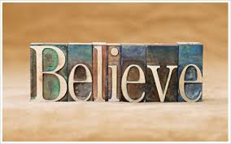


State Verbs
فراموش کردن
اعتقاد داشتن
احساس ... کردن
عاشق ... بودن

Slide 14
State Verbs
She believes in God.
She is believing in God.
او به خدا اعتقاد دارد.
I remembered her name.
I was remembering her name.
من نام او را به خاطر آوردم. ( اسم او یادم اومد.)

Slide 15
افعال مالکیت | افعال مربوط به عواطف، احساسات و نیاز ها | افعال مربوط به حس ها | افعال مربوط به بیان عقیده، نظر و فکر | سایر افعال
Have: داشتن | Love, like Hate, dislike | Feel: احساس کردن | believe | Seem: به نظر رسیدن
Own: داشتن | Need: نیاز داشتن | Smell: بو دادن | Remember, Forget | Look: به نظر رسیدن
Belong to: تعلق داشتن | Wish: آرزو داشتن | Taste: مزه دادن | Understand, know | Appear: به نظر رسیدن
Possess: داشتن، دارا بودن |  | Hear: شنیدن | Imagine | Sound: به نظررسیدن
 | Prefer: ترجیح دادن | See: دیدن | Agree, disagree
 |  |  | Realize, Recognize

Slide 16
have
See
Think
داشتن
State verb
خوردن
Action verb
دیدن
State verb
ملاقات کردن
Action verb
معتقد بودن
State verb
فکر کردن
Action verb

Slide 17
Want Remember
Protect Invent
Drive Donate
Have Need
Listen Forget
State verb
State verb
Action verb
Action verb
Action verb
Action verb
State verb
State verb
Action verb
State verb

Slide 18

حالا وقتشه بدونیم چه فرقی بین
Action Verbs
و
State Verbs
وجود داره

Slide 19
فعل های پویا (Action Verbs ( هم به صورت ساده ( حال ساده و گذشته ساده) و هم به صورت استمراری ( گذشته استمراری و حال استمراری ) استفاده می شوند.
فعل های ایستا ( (state verbsاکثر مواقع فقط به صورت ساده ( گذشته ساده و حال ساده ) می آیند.
We love our country.
We are loving our country.
His father owns a big house.
His father is owing a big house.

Slide 20
Choose the correct answer.
I (don’t like/ am not liking) reading newspapers.
At 3 o’clock yesterday, I (needed, was needing) a taxi.
3. She (watches/ is watching) television at the moment.
4. I (want/ am wanting) to go to the cinema tonight.
5. Unfortunately, he (didn’t remember/ wasn’t remembering) my name.

Slide 21


