Slide 1
Modal Verbs( افعال وجهی )
Form: can/ may/ must/ should + فعل
The translator can speak four languages.
The tourists may stay in Iran for two more days.
You must drive carefully.
Everyone should respect other people’s culture.
این افعال 2 ویژگی دارند:
بعد از آنها فعل به صورت ساده به کار می رود. (نمی توان به آخرشان اضافه کرد.)
با وجود آنها هنگام سؤالی و منفی کردن جملات، دیگر نیازی به افعال کمکی دیگر نخواهیم داشت.
Grammar
-s,-es,-ed,- ing
3.برای سوالی کردن جملاتی که فعل وجهی دارند فعل وجهی را به اول جمله انتقال می دهیم.
4.برای منفی کردن جملاتی که فعل وجهی دارند بعد از فعل وجهی not می آوریم.

Slide 2
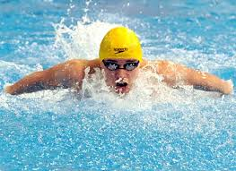

موارد کاربرد فعل کمکی can :
1- توانايی انجام کار يا عملی در زمان حال يا آيندهAbility ) ) :
1-I can speak French.
2-He can swim well.
2- درخواست انجام کار يا عملیRequest ) ) :
3- Can you help me lift this box?
4- Can you answer the phone, please?
3- پيشنهاد انجام کار يا عملیOffer ) ) :
5- Can I get you a cup of coffee?
6- We can eat in a restaurant if you like.
4- اجازه انجام کار يا عملیPermission ) ) :
7-You can go if you want to.
8-You can park here. It is no parking zone.

Slide 3


موارد کاربرد فعل کمکی:may
1- برای احتمال کار يا عملی در زمان حال يا آينده Possibility ) ):
1- It may rain tomorrow.
2- It may be late, so don't wait for me.
2- اجازه انجام کار يا عملی Permission ) ) بيشتر در سبک رسمی :
3- May I use your cellphone?
4- May I leave the classroom?
3- برای بيان آرزو و اميد (Wishes and Hopes) :
5- May God be with you.
6- May she rest in peace.

Slide 4
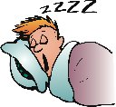
موارد کاربرد Should :
1- برای بيان نصيحت ، توصيه و بهتر بودن انجام کار يا عملی در زمان حال و آينده (Advice & recommendation)
1.You look tired. You should go to bed.
2.I think the government should do more to help homeless people.
2- برای بيان انجام وظيفه و مسوليت ( Responsibility or Duty ) :
3.I should visit my parents more often.
4.A student shouldn't waste his parents' money.
3- برای بيان انتظار ( Expectations ) :
5.We should reach the airport in about twenty minutes. (The traffic is not heavy. The streets are dry. I only live eight miles from the airport. I have made this trip many times.)
6.Ali should get an A in grammar. ( He has received high grades on all his tests, attends all classes and completes all homework.)

Slide 5
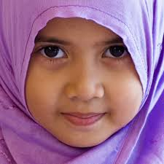
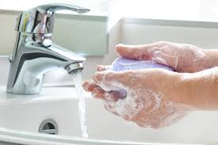
موارد کاربرد (must) :
1- برای بيان الزام و ضرورت شديد شخصی: ( Strong Personal Obligation/ Necessity)
1. I must go to bed earlier.
2.I must buy some new clothes. My clothes look so old.
2- برای بيان استنباط و نتيجه گيری (Deduction and Conclusion) :
3.He is so small. He must be no more than 4 years old.
4.You must be Anna's sister- you look like her.
3- در اطلاعيه های عمومی و علايم هشدار دهنده که نشانگر قوانين ، امر و نهی و ... می باشد.
5.You must wash your hands before returning to work.
6.You must leave the building if the fire alarm sounds.

Slide 6
B. Read the following examples. Compare their meanings.
Affirmative
I
You can speak English.
He may watch TV
She must get a passport first.
We should be careful in a foreign country.
They

Slide 7
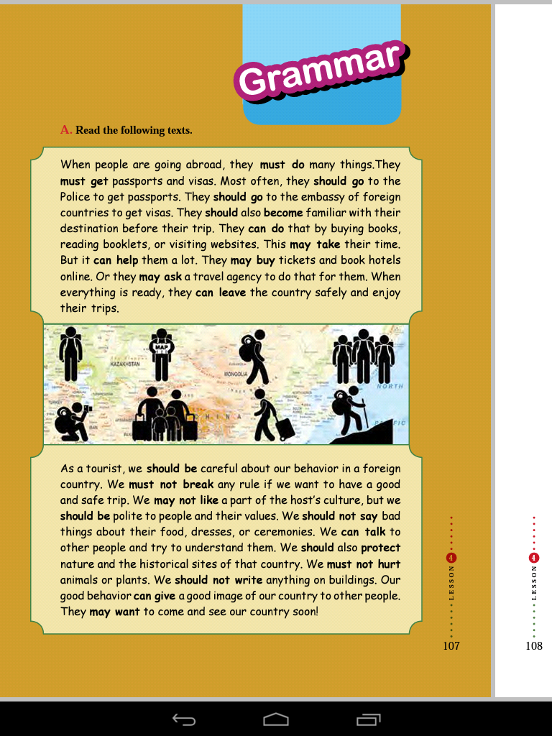
A. Read the following texts.

Slide 8
Negative
I
You cannot(can’t)speak Japanese.
He may not watch TV.
She must not get a passport first.
We should not(shouldn’t)be careless in a foreign country.
They
Children must not eat fast food. It is not good for their health.
Please help me. I cannot swim.

Slide 10
نکته:
فعل may not برخلاف بقیه افعال مدال صورت مخفف ندارد.
Modal + not + verb | صورت مخفف
can not study | cant study
must not study | mustn't study
should not | shouldn’t study
may not study | may not study

Slide 11
Interrogative
I
Can you speak Korean?
May He watch TV?
Must She get a passport first?
Should We be careful in a foreign country?
They
Should travelers protect nature?
May I sit down?

