Slide 1

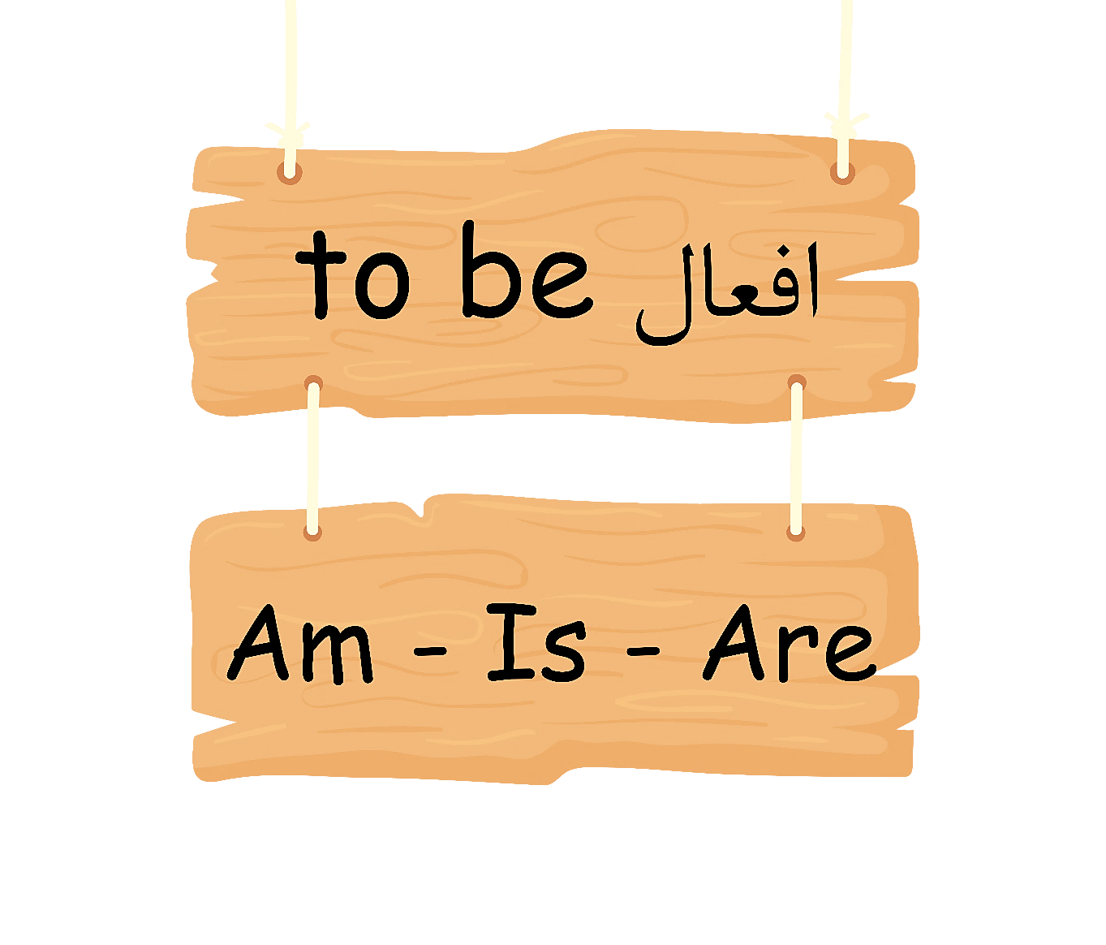


Slide 2
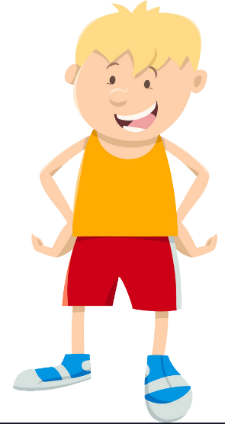
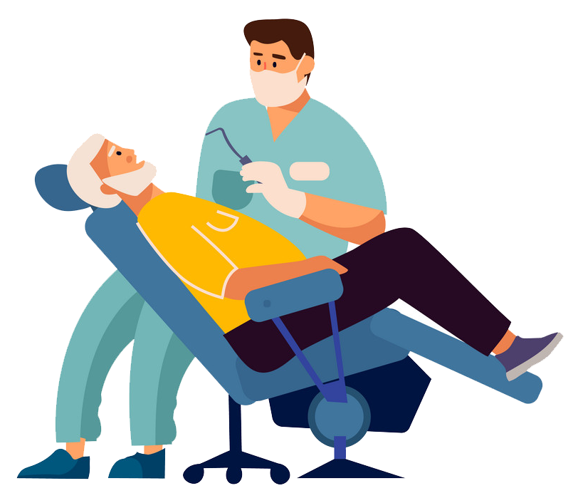


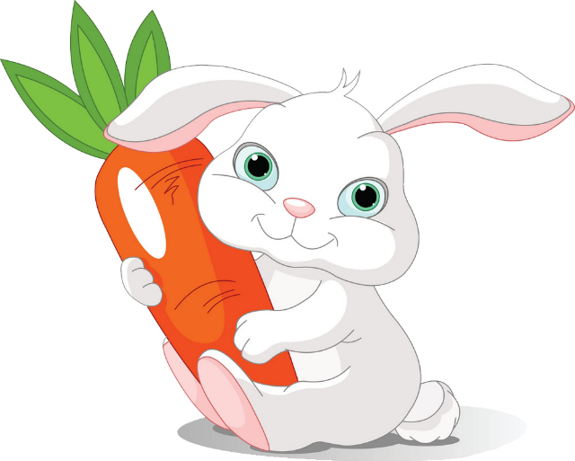
I am a boy.
You are a dentist.
He is an engineer.
She is a teacher.
It is a rabbit.

Slide 3
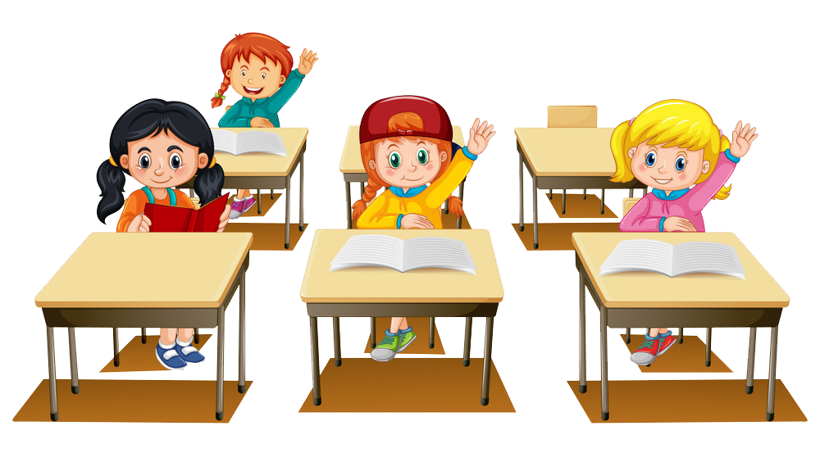
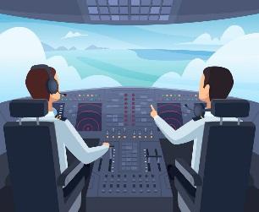
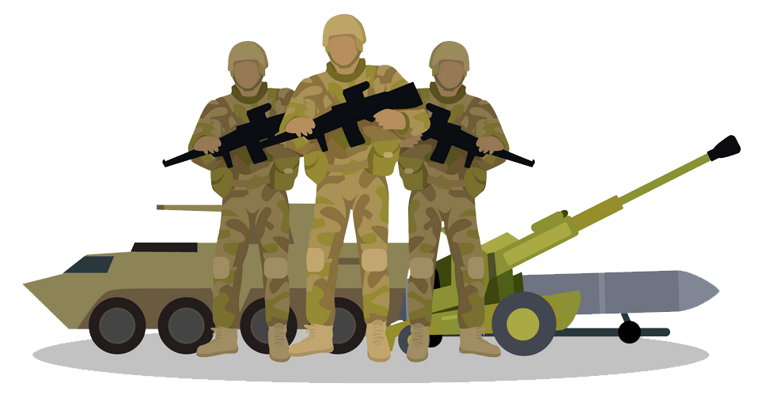
We are students.
You are pilots.
They are soldiers.

Slide 4
singular | plural
I am a boy. | We are students.
You are a dentist. | You are pilots.
He is an engineer. | They are soldiers.
She is a teacher.
It is a rabbit.

Slide 5
Affirmative (جملات مثبت)
I | am | happy.
He She It | is
We You They | are
Ali is clever.
It is red.
Zahra and Nadia are generous.
am ، is، are به معنای «هستن» می باشد.

Slide 6
Question (جملات سوالی)
Am | I | careful?
Is | he she
Are | we you they
با آوردن am ، is، are به اوّل جمله، آنها را سؤالی می‌کنیم.

Slide 7
Negative sentences
(جملات منفی)
با اضافه کردن not یا n’t بعد از am ، is، are آنها را منفی می‌کنیم.
I am not talkative.
He is not shy.
‏They are not rude.
نکته: am not شکل مخفّف ندارد.

Slide 8
There | is | an | eraser اسم مفرد | in the classroom
 |  | a one | computer اسم مفرد
 | are | two three many some | students boxes اسم جمع

Slide 9
تفاوت there is و there are
there is به معنای وجود دارد یا هست می‌باشد و همراه اسم مفرد می‌آید.
there are به معنای وجود دارند یا هستند می‌باشد و همراه اسم جمع می‌آید.

Slide 10
جمله سؤالی
Is there an apple on the table? Yes there is.
جمله منفی
There aren’t/are not many tourists in this city.
there is و there are را مانند am ، is ،are سؤالی و منفی می‌کنیم.

Slide 11
نکات مهم
there is به معنای وجود دارد و هست، می‌باشد. there are به معنای وجود دارند و هستند، می‌باشد.
برای یکی از there is و برای بیش از یکی از there are استفاده می کنیم.
بعد از there is و قبل از اسم از a یا an استفاده می کنیم.
برای کلماتی که با حروف صدادار (u – o – i – e – a) شروع می‌شود از an استفاده می‌کنیم.
برای کلماتی که با حروف غیر صدادار شروع می‌شوند از a استفاده می‌کنیم.
بعد از there is اسم مفرد و بعد از there are اسم جمع می‌آید.
برای منفی کردن این عبارات بعد از is و are کلمه not به‌کار می‌بریم.
برای سوالی کردن این عبارات کافی است is و are را ابتدای جمله بیاوریم.

Slide 12
There is , There are
There | is | an | apple | on the table
There | is | a | pencil | in the pencil case
There | is | one | computer | at home
There | are | two | books | in the bag
There | are | three | buses | in the street
There | are | many | students | in the classroom
There | are | some | boxes | on the table

Slide 13
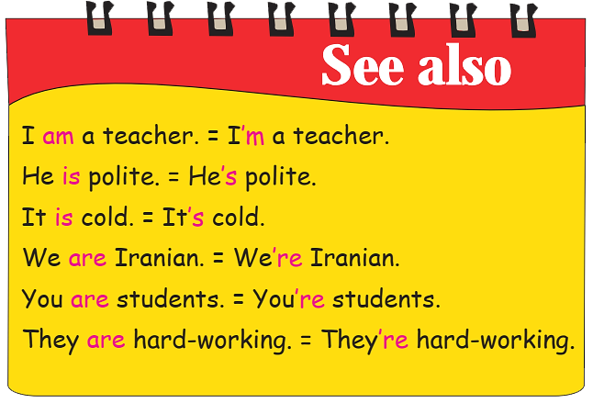
جملات مخفف

Slide 14
I’m not talkative. = I amn’t talkative.
He’s not shy. = He isn’t shy.
They’re not rude. = They aren’t rude.
is not = isn’t
are not = aren’t
‏am not = مخفف ندارد

Slide 15
Affirmative | Short from | Question
‏I am | I’m | Am I
You are | You’re | Are you
He is | He’s | Is he
She is | She’s | Is she
It is | It’s | Is it
We are | We’re | Are we
You are | You’re | Are you
They are | They’re | Are they

